Slide 1
Generator
Verteiltes Sudoku
Apache Camel, ZeroMQ, REST, Python

Slide 2
Kontext
Solver
Broker
Generator
GUI

Slide 3
Architektur
HTTP/REST
Camel
Receiver
Register, Pong
Bridge
Solve, Display
Handler
Generator
Notes:
Blau: Python / Grün: Java; Jeweils 1 Thread

Slide 4
Bussineslogik
HTTP/REST
Camel
Receiver
Register, Pong
Bridge
Solve, Display
Handler
Generator
Notes:
Blau: Python / Grün: Java; Jeweils 1 Thread

Slide 5
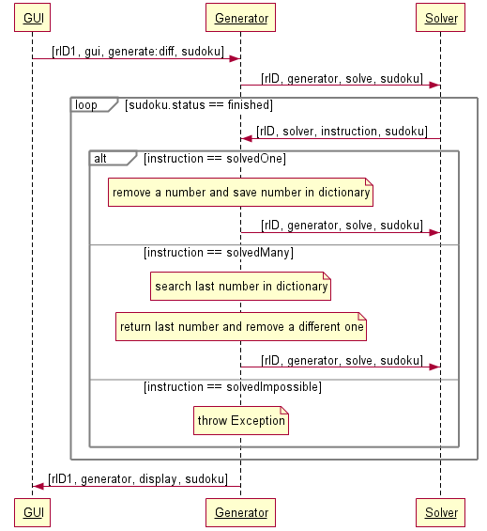
Sequenzdiagramm

Slide 6
Generate
Gültigkeit ((math.sqrt(len(sudoku))) % 1) == 0
Senken der Netzwerklast len(msg.sudoku) == 1

Slide 7
Initial Sudoku
1 | 2 | 3 | 4 | 5 | 6 | 7 | 8 | 9
4 | 5 | 6 | 7 | 8 | 9 | 1 | 2 | 3
7 | 8 | 9 | 1 | 2 | 3 | 4 | 5 | 6
2 | 3 | 4 | 5 | 6 | 7 | 8 | 9 | 1
5 | 6 | 7 | 8 | 9 | 1 | 2 | 3 | 4
8 | 9 | 1 | 2 | 3 | 4 | 5 | 6 | 7
3 | 4 | 5 | 6 | 7 | 8 | 9 | 1 | 2
6 | 7 | 8 | 9 | 1 | 2 | 3 | 4 | 5
9 | 1 | 2 | 3 | 4 | 5 | 6 | 7 | 8

Slide 8
Swap Numbers
1 | 2 | 3 | 4 | 5 | 6 | 7 | 8 | 9
4 | 5 | 6 | 7 | 8 | 9 | 1 | 2 | 3
7 | 8 | 9 | 1 | 2 | 3 | 4 | 5 | 6
2 | 3 | 4 | 5 | 6 | 7 | 8 | 9 | 1
5 | 6 | 7 | 8 | 9 | 1 | 2 | 3 | 4
8 | 9 | 1 | 2 | 3 | 4 | 5 | 6 | 7
3 | 4 | 5 | 6 | 7 | 8 | 9 | 1 | 2
6 | 7 | 8 | 9 | 1 | 2 | 3 | 4 | 5
9 | 1 | 2 | 3 | 4 | 5 | 6 | 7 | 8
1 | 5 | 3 | 4 | 2 | 6 | 7 | 8 | 9
4 | 2 | 6 | 7 | 8 | 9 | 1 | 5 | 3
7 | 8 | 9 | 1 | 5 | 3 | 4 | 2 | 6
5 | 3 | 4 | 2 | 6 | 7 | 8 | 9 | 1
2 | 6 | 7 | 8 | 9 | 1 | 5 | 3 | 4
8 | 9 | 1 | 5 | 3 | 4 | 2 | 6 | 7
3 | 4 | 2 | 6 | 7 | 8 | 9 | 1 | 5
6 | 7 | 8 | 9 | 1 | 5 | 3 | 4 | 2
9 | 1 | 5 | 3 | 4 | 2 | 6 | 7 | 8

Slide 9
Swap Rows
1 | 5 | 3 | 4 | 2 | 6 | 7 | 8 | 9
4 | 2 | 6 | 7 | 8 | 9 | 1 | 5 | 3
7 | 8 | 9 | 1 | 5 | 3 | 4 | 2 | 6
5 | 3 | 4 | 2 | 6 | 7 | 8 | 9 | 1
2 | 6 | 7 | 8 | 9 | 1 | 5 | 3 | 4
8 | 9 | 1 | 5 | 3 | 4 | 2 | 6 | 7
3 | 4 | 2 | 6 | 7 | 8 | 9 | 1 | 5
6 | 7 | 8 | 9 | 1 | 5 | 3 | 4 | 2
9 | 1 | 5 | 3 | 4 | 2 | 6 | 7 | 8
1 | 5 | 3 | 4 | 2 | 6 | 7 | 8 | 9
4 | 2 | 6 | 7 | 8 | 9 | 1 | 5 | 3
7 | 8 | 9 | 1 | 5 | 3 | 4 | 2 | 6
5 | 3 | 4 | 2 | 6 | 7 | 8 | 9 | 1
2 | 6 | 7 | 8 | 9 | 1 | 5 | 3 | 4
8 | 9 | 1 | 5 | 3 | 4 | 2 | 6 | 7
9 | 1 | 5 | 3 | 4 | 2 | 6 | 7 | 8
6 | 7 | 8 | 9 | 1 | 5 | 3 | 4 | 2
3 | 4 | 2 | 6 | 7 | 8 | 9 | 1 | 5

Slide 10
Swap Blocks
1 | 5 | 3 | 4 | 2 | 6 | 7 | 8 | 9
4 | 2 | 6 | 7 | 8 | 9 | 1 | 5 | 3
7 | 8 | 9 | 1 | 5 | 3 | 4 | 2 | 6
5 | 3 | 4 | 2 | 6 | 7 | 8 | 9 | 1
2 | 6 | 7 | 8 | 9 | 1 | 5 | 3 | 4
8 | 9 | 1 | 5 | 3 | 4 | 2 | 6 | 7
9 | 1 | 5 | 3 | 4 | 2 | 6 | 7 | 8
6 | 7 | 8 | 9 | 1 | 5 | 3 | 4 | 2
3 | 4 | 2 | 6 | 7 | 8 | 9 | 1 | 5
5 | 3 | 4 | 2 | 6 | 7 | 8 | 9 | 1
2 | 6 | 7 | 8 | 9 | 1 | 5 | 3 | 4
8 | 9 | 1 | 5 | 3 | 4 | 2 | 6 | 7
1 | 5 | 3 | 4 | 2 | 6 | 7 | 8 | 9
4 | 2 | 6 | 7 | 8 | 9 | 1 | 5 | 3
7 | 8 | 9 | 1 | 5 | 3 | 4 | 2 | 6
9 | 1 | 5 | 3 | 4 | 2 | 6 | 7 | 8
6 | 7 | 8 | 9 | 1 | 5 | 3 | 4 | 2
3 | 4 | 2 | 6 | 7 | 8 | 9 | 1 | 5

Slide 11
Rotate Sudoku
5 | 3 | 4 | 2 | 6 | 7 | 8 | 9 | 1
2 | 6 | 7 | 8 | 9 | 1 | 5 | 3 | 4
8 | 9 | 1 | 5 | 3 | 4 | 2 | 6 | 7
1 | 5 | 3 | 4 | 2 | 6 | 7 | 8 | 9
4 | 2 | 6 | 7 | 8 | 9 | 1 | 5 | 3
7 | 8 | 9 | 1 | 5 | 3 | 4 | 2 | 6
9 | 1 | 5 | 3 | 4 | 2 | 6 | 7 | 8
6 | 7 | 8 | 9 | 1 | 5 | 3 | 4 | 2
3 | 4 | 2 | 6 | 7 | 8 | 9 | 1 | 5
1 | 4 | 7 | 9 | 3 | 6 | 8 | 2 | 5
9 | 3 | 6 | 8 | 5 | 2 | 7 | 4 | 1
8 | 5 | 2 | 7 | 1 | 4 | 6 | 3 | 9
7 | 1 | 4 | 6 | 9 | 3 | 2 | 5 | 8
6 | 9 | 3 | 2 | 8 | 5 | 4 | 1 | 7
2 | 8 | 5 | 4 | 7 | 1 | 3 | 9 | 6
4 | 7 | 1 | 3 | 6 | 9 | 5 | 8 | 2
3 | 6 | 9 | 5 | 2 | 8 | 1 | 7 | 4
5 | 2 | 8 | 1 | 4 | 7 | 9 | 6 | 3

Slide 12
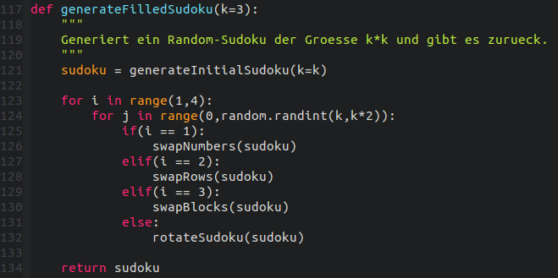
Randomisierung

Slide 13

Generate
SolverRequestID
Difficulty
Filled Sudoku
CleanedNumbers
MemorySet
GuiRequestID

Slide 14

Generate
1 |  | 3 | 4 | 5 | 6 | 7 | 8 | 9
4 | 5 | 6 | 7 | 8 | 9 | 1 |  | 3
7 | 8 | 9 | 1 | 2 |  | 4 | 5 | 6
2 | 3 | 4 | 5 | 6 | 7 | 8 | 9 | 1
5 |  | 7 | 8 |  | 1 | 2 | 3 | 4
8 | 9 | 1 | 2 | 3 | 4 |  | 6 | 7
3 | 4 | 5 | 6 | 7 | 8 | 9 | 1 | 2
6 | 7 |  | 9 |  | 2 | 3 | 4 | 5
9 | 1 | 2 | 3 | 4 | 5 | 6 | 7 | 8
Solver

Slide 15


SolvedOne
Gültigkeit der Antwort
ID ?

Slide 16

SolvedOne
1 |  | 3 | 4 | 5 | 6 | 7 | 8 | 9
4 | 5 | 6 | 7 | 8 | 9 | 1 |  | 3
7 | 8 | 9 | 1 | 2 |  | 4 | 5 | 6
2 | 3 | 4 | 5 | 6 | 7 | 8 | 9 | 1
5 |  | 7 | 8 |  | 1 | 2 | 3 | 4
8 | 9 | 1 | 2 | 3 | 4 |  | 6 | 7
3 | 4 | 5 | 6 | 7 | 8 | 9 | 1 | 2
6 | 7 |  | 9 |  | 2 | 3 |  | 5
9 | 1 | 2 | 3 | 4 | 5 | 6 | 7 | 8

Slide 17

SolvedOne
1 |  | 3 | 4 | 5 | 6 | 7 | 8 | 9
4 | 5 | 6 | 7 | 8 | 9 | 1 |  | 3
7 | 8 | 9 | 1 | 2 |  | 4 | 5 | 6
2 | 3 | 4 | 5 | 6 | 7 | 8 | 9 | 1
5 |  | 7 | 8 |  | 1 | 2 | 3 | 4
8 | 9 | 1 | 2 | 3 | 4 |  | 6 | 7
3 | 4 | 5 | 6 | 7 | 8 | 9 | 1 | 2
6 | 7 |  | 9 |  | 2 | 3 |  | 5
9 | 1 | 2 | 3 | 4 | 5 | 6 | 7 | 8

Slide 18

SolvedOne
1 |  | 3 | 4 | 5 | 6 | 7 | 8 | 9
4 | 5 | 6 | 7 | 8 | 9 | 1 |  | 3
7 | 8 | 9 | 1 | 2 |  | 4 | 5 | 6
2 | 3 | 4 | 5 | 6 | 7 | 8 | 9 | 1
5 |  | 7 | 8 |  | 1 | 2 | 3 | 4
8 | 9 | 1 | 2 | 3 | 4 |  | 6 | 7
3 | 4 | 5 | 6 | 7 | 8 | 9 | 1 | 2
6 | 7 |  | 9 |  | 2 | 3 |  | 5
9 | 1 | 2 | 3 | 4 | 5 | 6 | 7 | 8

Slide 19

SolvedMany
Gültigkeit der Antwort
Eine "falsche Zahl" entfernt

Slide 20
SolvedMany
1 |  | 3 | 4 | 5 | 6 | 7 | 8 | 9
4 | 5 | 6 | 7 | 8 | 9 | 1 |  | 3
7 | 8 |  | 1 | 2 |  | 4 | 5 | 6
2 | 3 | 4 | 5 | 6 | 7 | 8 | 9 | 1
5 |  | 7 | 8 |  | 1 | 2 | 3 | 4
8 | 9 | 1 | 2 | 3 | 4 |  | 6 | 7
3 | 4 | 5 | 6 | 7 | 8 | 9 | 1 | 2
6 | 7 |  | 9 |  | 2 | 3 |  | 5
9 | 1 | 2 | 3 | 4 | 5 | 6 | 7 | 8

Slide 21
SolvedMany
1 |  | 3 | 4 | 5 | 6 | 7 | 8 | 9
4 | 5 | 6 | 7 | 8 | 9 | 1 |  | 3
7 | 8 | 9 | 1 | 2 |  | 4 | 5 | 6
2 | 3 | 4 | 5 | 6 | 7 | 8 | 9 | 1
5 |  | 7 | 8 |  | 1 | 2 | 3 | 4
8 | 9 | 1 | 2 | 3 | 4 |  | 6 | 7
3 | 4 | 5 | 6 | 7 | 8 | 9 | 1 | 2
6 | 7 |  | 9 |  | 2 | 3 |  | 5
9 | 1 | 2 | 3 | 4 | 5 | 6 | 7 | 8

Slide 22

SolvedMany
1 |  | 3 | 4 | 5 | 6 | 7 | 8 | 9
4 | 5 | 6 | 7 | 8 | 9 | 1 |  | 3
7 | 8 | 9 | 1 | 2 |  | 4 | 5 | 6
2 | 3 | 4 | 5 | 6 | 7 | 8 | 9 | 1
5 |  | 7 | 8 |  | 1 | 2 | 3 | 4
8 | 9 | 1 | 2 | 3 | 4 |  | 6 | 7
3 | 4 | 5 | 6 | 7 | 8 | 9 | 1 | 2
6 | 7 |  | 9 |  | 2 | 3 |  | 5
9 | 1 | 2 | 3 | 4 | 5 | 6 | 7 | 8

Slide 23
SolvedMany
 |  | 3 | 4 | 5 | 6 | 7 | 8 | 9
4 | 5 | 6 | 7 | 8 | 9 | 1 |  | 3
7 | 8 | 9 | 1 | 2 |  | 4 | 5 | 6
2 | 3 | 4 | 5 | 6 | 7 | 8 | 9 | 1
5 |  | 7 | 8 |  | 1 | 2 | 3 | 4
8 | 9 | 1 | 2 | 3 | 4 |  | 6 | 7
3 | 4 | 5 | 6 | 7 | 8 | 9 | 1 | 2
6 | 7 |  | 9 |  | 2 | 3 |  | 5
9 | 1 | 2 | 3 | 4 | 5 | 6 | 7 | 8

Slide 24
Senden
HTTP/REST
Camel
Receiver
Register, Pong
Bridge
Solve, Display
Handler
Generator
Notes:
Die Bridge verbindet die Businesslogik mit Camel
Drei Schritte:
Wie bekommen wir unsere Informationen zur Bridge?
Wie bekommen wir grundsätzlich nachrichten von Python zu Camel
Was tut Camel?

Slide 25

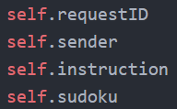
Messages
Camel
Receiver
Bridge
Handler
Generator
↪ send(message)
Message.py
Notes:
Informationen zur Bridge:
Straightforward: Messages

Slide 26



Python & Camel
Camel
Bridge
Notes:
Blau: Python / Grün: Java; Jeweils 1 Thread
ZMQ ist eine Bibliothek, die es für eine Vielzahl von Sprachen gibt, unter anderem für Python und Java.

Slide 27

ZMQ Messages
2inR2aoDR4WXMQ12e5BX 2Qw1W1ptcPUbDjcQ5Mge DYpyMph8SpzbpW5K7hS8 gCvCdBqYeWLTAKSvJWeS FiA1PorymmKhaKns7zXr h5vBmhX0EVtxErwL6HkBfRwLksMvvWWBwDreKM03 j8Wl9QBd6P2yX45zPOH8 8migVgPTHLfwWyfoJ7qY lXm1LYDypvvV6vFnp3tS Afbtwdg3j9yX6H99RlzX
String
Atomic
Notes:
Diese Folie ist in Anlehung an den Vortrag den wir vorhin gesehen haben.
Messages haben zwei Eigenschaften:
Sie sind String, dh
Wir können alles senden
müssen aber Objekte Serialisieren (TODO)
Atomic heißt
Die Nachricht kommt ganz oder gar nicht an. Wer 1GB versendet bekommt ein GB oder nichts
Impliziert, dass zmq ein kleines eigenes Framing außen rum packt.
Der vollständigkeit halber sei erwähnt: Messges haben noch eine Dritte Kerneigenschaft: Multipart, die wir uns hier aus Zeitgründen aber nicht ansehen

Slide 28
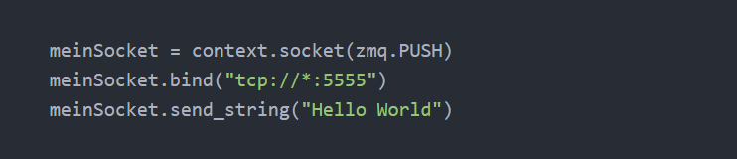

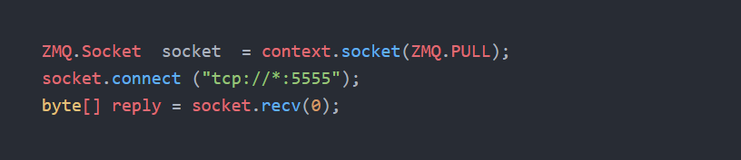

ZMQ verwenden

Slide 29
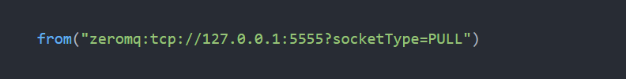

ZMQ verwenden
Notes:
Camel unterstützt ZMQ auch direkt

Slide 30
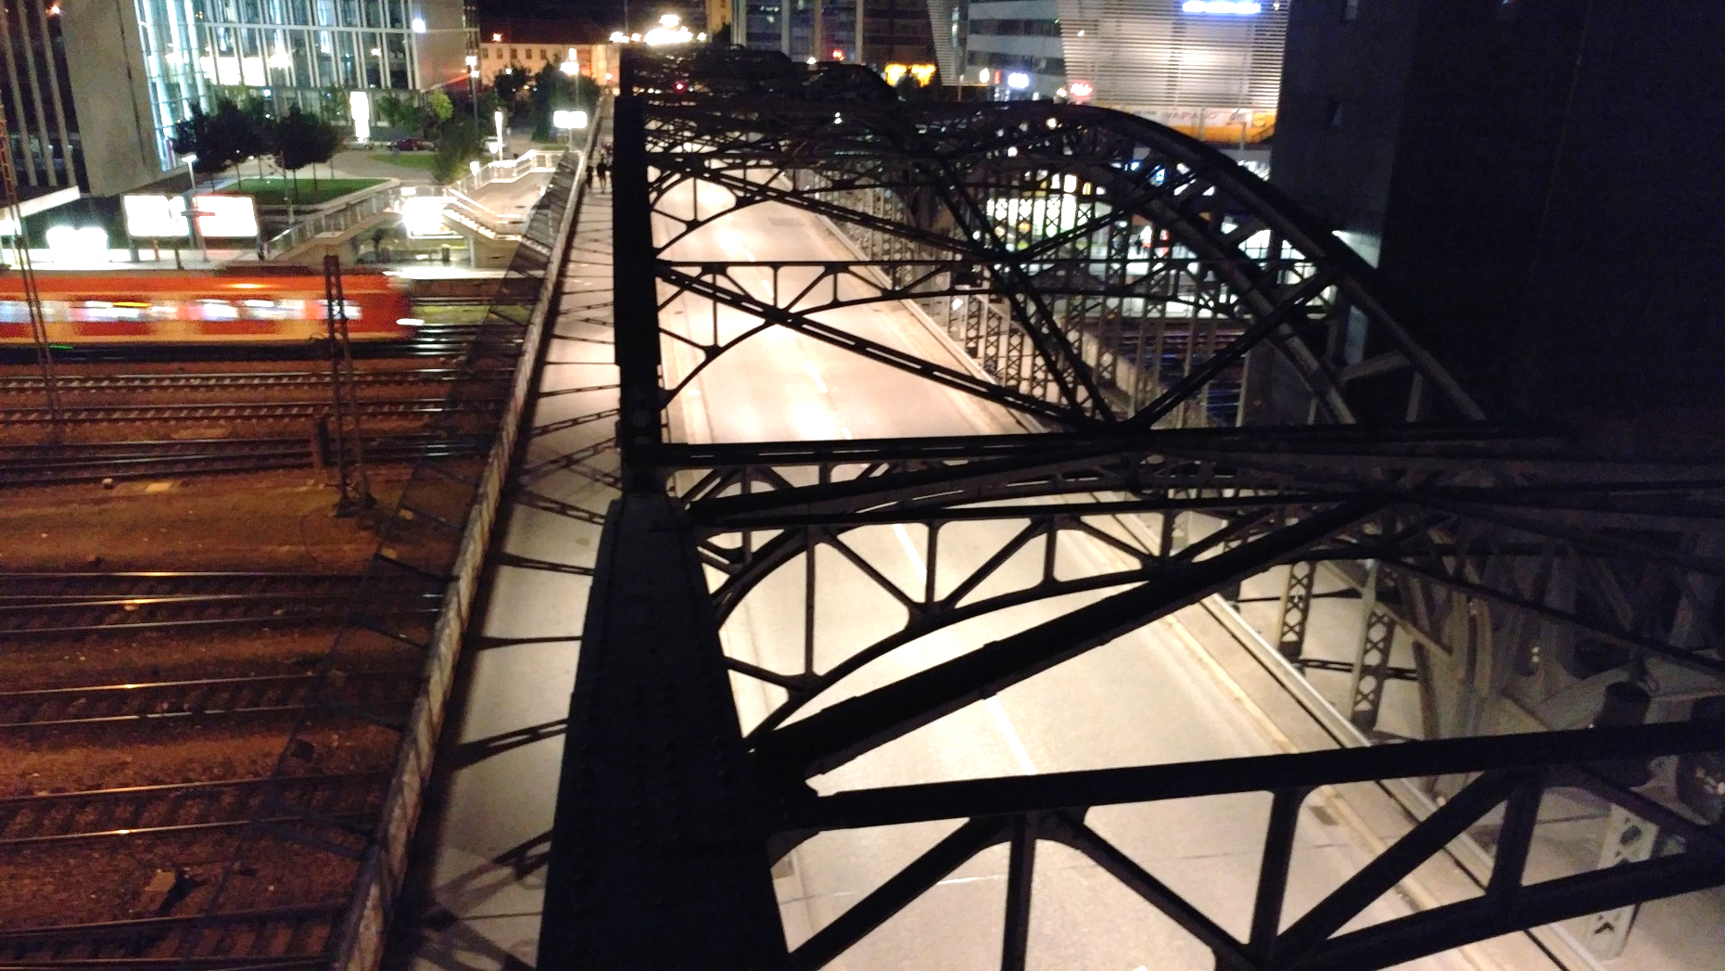
Bridge.py
Notes:
Zeile 15
Socket anlegen
Zeile 19-21 (send-Methode)
Send-String aufbauen (durch „;“ separiert)
Versenden

Slide 31
Camel Route
from
process
to
from(String)
.process(Processor)
.to(String)

Slide 32
Camel Processor
Input
Output
936DA01F[…];
restlet:http://[…];
register:generator;
[[1, 2, 3], [4, 5, 6]]
{
"request_id":
"936DA01F[…]",
"sender":
"restlet:http://[…]",
"instruction":
"register:generator",
"sudoku":
[1,2,3,4,5,6]
}
Notes:
Passiert nicht viel, dass Array wird geflattet.
Semikolon ist intern unser Trennzeichen.

Slide 33
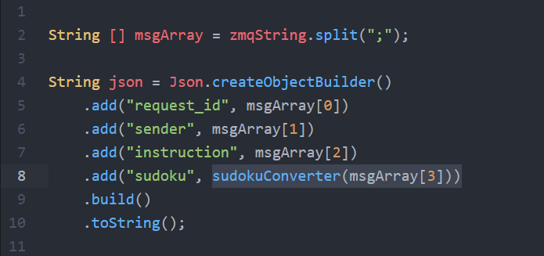
Camel Processor
Notes:
Wir verwenden da die Klasse JSON und abschließend ein toString().
Die Methode sudokoConverter liefert selbst wieder ein Flaches JSON Array zurück, damit es beim Parsen nachher keine Probleme gibt.
Sonst hätte man da statt JSON Array einen String „[1,2,3,4,5,6]“

Slide 34
Empfangen
HTTP/REST
Camel
Receiver
Register, Pong
Bridge
Solve, Display
Handler
Generator
Notes:
Blau: Python / Grün: Java; Jeweils 1 Thread

Slide 35
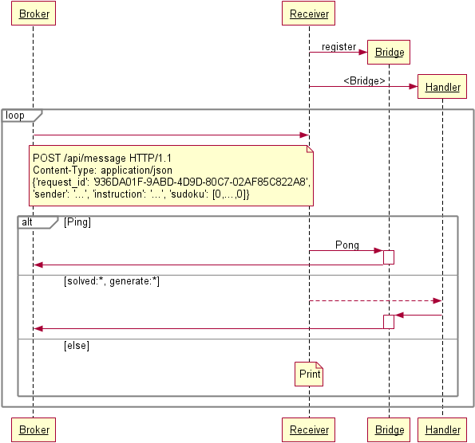
Empfangen

Slide 36
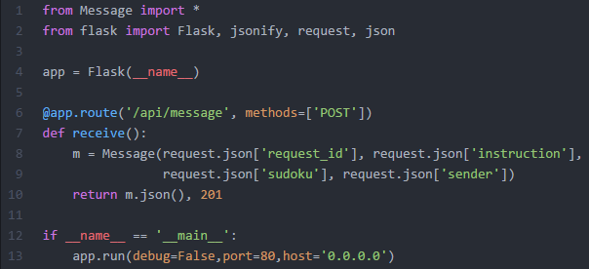
Empfangen

Slide 37

Empfangen
Camel Rest Endpoint
nur als From
Endpoint
restlet:http://<IP>/api/message?restletMethod=post

Slide 38
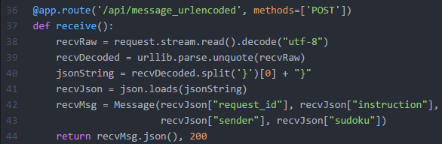
Empfangen

Slide 39


Anmerkungen
Clojure

Slide 40
Clojure
Code
Compiler
Bytecode
JVM

Slide 41
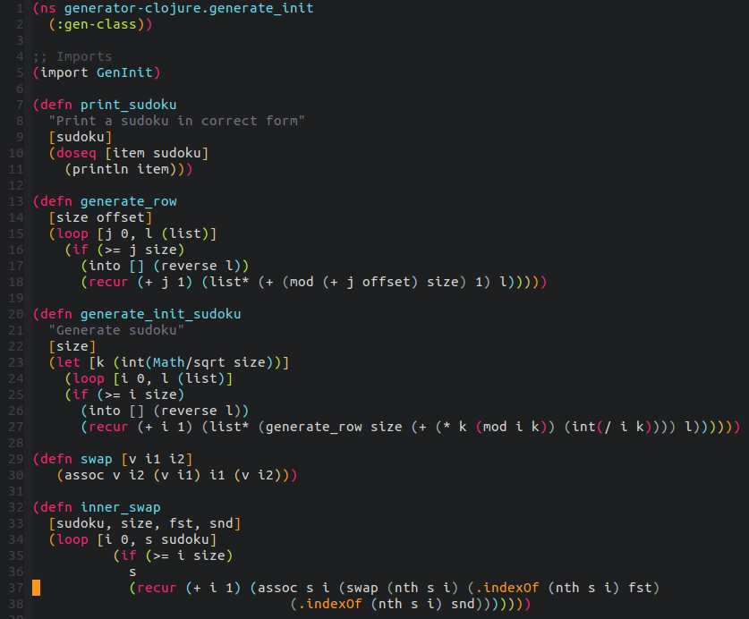
Clojure

Slide 42
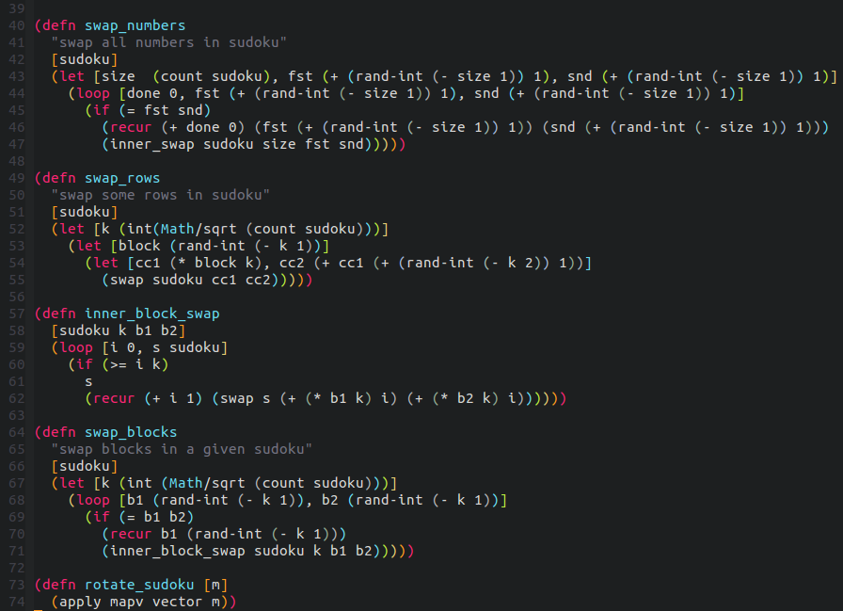
Clojure

Slide 43
Architektur
HTTP/REST
Camel
Receiver
Register, Pong
Bridge
Solve, Display
Handler
Generator
Notes:
Blau: Python / Grün: Java; Jeweils 1 Thread

